Slide 1
4.2.3.3 Inferential testing

Slide 2
Students should demonstrate knowledge and understanding of inferential testing and be familiar with the use of inferential tests.
• Introduction to statistical testing; the sign test.
• Probability and significance: use of statistical tables and critical values in interpretation of significance; Type I and Type II errors.
• Factors affecting the choice of statistical test, including level of measurement and experimental design.
When to use the following tests: Spearman’s rho, Pearson’s r, Wilcoxon, Mann-Whitney, related t-test, unrelated t-test and Chi-Squared test.

Slide 3
What is Inferential testing?
we use inferential statistics to try to infer from the sample data what the population might think. Or, we use inferential statistics to make judgments of the probability that an observed difference between groups is a dependable one or one that might have happened by chance in this study.
We infer ideas from the results. Eg: drinking 2 units of alcohol will slow your reaction time.

Slide 4
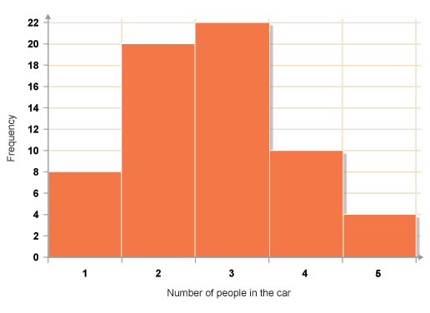
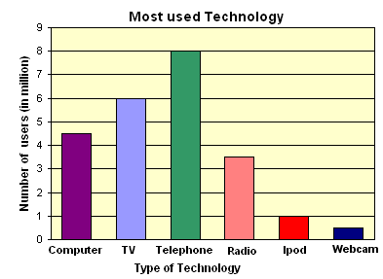
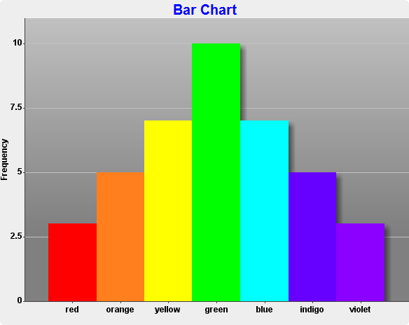
What is wrong with Stats

Slide 5
The sign test
Students need to understand the idea that differences between two groups can be caused by chance and that a stats test is calculating the probability that chance has caused that difference.

Slide 6
The students should be instructed to flip a coin 5 times and to count how many times it lands tails. Then, the students should be instructed to flip a coin 5 times again but this time to use ‘mind power’ to will the coin to land tails – ensure they take this seriously! Again, they should record how many times the coin lands tails.

Slide 7
Tabulate
Participant | Condition 1: Amount of tails | Condition 2 (mind power): Amount of tails | Difference (condition 2 – condition 1) | Sign
1
2
3
4
5
6
7
8
9
10

Slide 8
Following this data collection, there are lots of opportunities to consolidate research methods skills such as calculating the mean, drawing bar charts, identifying the independent and dependent variables, writing hypotheses, etc.

Slide 9
Once the mean amount of tails for each condition have been calculated, it is likely that you can discuss the fact that there is a difference between the two conditions. So, does that mean that mind power genuinely influenced the result? The students should get the idea that despite the fact that there is a difference between the two conditions (if there isn’t, quietly fudge the results!), it is probably the result of luck/chance… however, to be objective about it, a statistical test should be used to determine whether the probability of the difference being caused by chance is low… and therefore mind power did influence the result!

Slide 10
Sign test
A statistical test used to analyse the direction of differences of scores between the same or matched pairs of subjects under two experimental conditions
http://www.mathcracker.com/sign-test.php

Slide 11
Notes
Binomial Sign Test
The term binomial is often referred to as giving something a two part name.
For example, a popular every day example, is examining the question about the sauce made out of tomatoes? Brits called it tomato sauce, whereas Americans call it ketchup. In this instance, the sauce made out of tomatoes is given two names but means exactly the same thing, given which country you are living in. Another example is when animals/species are given Latin names.
In terms of mathematics, when speaking algebraically, it means looking at the difference or sum amongst two terms.
In the context of Psychology, it can be referred to the difference in the participants’ behaviour across two conditions/levels of the IV.

Slide 12
Checklist for using the Binomial test:
DV produces nominal type data
Repeated Measures design
Exploring a difference between each condition (levels of the IV).

Slide 13
Calculations Example of Binomial Sign Test
Two students wanted to examine whether their peers would be willing to share their French fries when in the school refectory. The two students wanted to know if a celebrity was sitting on their table or if students from another school were sitting on their table, would their peers be willing to share their French Fries. They hypothesised that students would be more likely to share with a celebrity.

Slide 14
Table (1) to show participants willingness to share their French fries with a celebrity
Participant | Share French fries with celebrity (Condition A) | Share French fries with students from another school (Condition B)
1 | yes | no
2 | no | yes
3 | yes | yes
4 | yes | no
5 | no | yes
6 | no | no
7 | yes | no
8 | no | yes
9 | no | yes
10 | yes | no

Slide 15
Step one:
Data is categorised into a table of results.
Step two:
Positive and negative signs need to be added. In this case if condition A is yes and condition B is no a plus is added and the opposite would be a minus.
Participant | Share French fries with celebrity (Condition A) | Share French fries with students from another school (Condition B) | Flow of direction
1 | yes | no | +
2 | no | yes | –
3 | yes | yes | ignore
4 | yes | no | +
5 | no | yes | –
6 | no | no | Ignore
7 | yes | no | +
8 | no | yes | –
9 | no | yes | –
10 | yes | no | +

Slide 16
Step three:
This step requires the counting of each positive and negative sign assigned to each participant’s scores.
YES-NO (+) TOTAL = 3
NO-YES (-) TOTAL = 5
Step four:
The smallest of the total direction scores is the overall binomial test result = 3.
This is the observed value of S = 3
Step five:
Level of significance - this requires looking at a Binomial sign test critical values table.
N | 0.05 | 0.01
5 | 0
6 | 0 | 0
7 | 0 | 0
8 | 1 | 0
9 | 1 | 1
10 | 1 | 1
11 | 2 | 1
12 | 2 | 2
13 | 3 | 2
14 | 3 | 2
15 | 3 | 3
The level of significance is 0.05 for a 1 tailed test.
N = number of participants whose scores were use. This means ignoring the same scores, for example,
“no no”
In this example, Number of participants scores used = 8 participants.
Therefore, the critical Binomial Sign test value = 1

Slide 17
Does this mean the study was significant?
In this example,
The observed Binomial Sign test value = 3
The critical Binomial Sign test value = 1
In order for the study to be significant, the observed value has to be smaller or equal to the critical Binomial Signs test value.
In this worked example, the observed Binomial Signs test value is greater than the critical value. Therefore, this suggests the study is not significant as the level of sharing amongst the Psychology students peers does not affect their willingness to share French fries with either a celebrity or other students from a different school. As a result, the null hypothesis is accepted.

Slide 18
Probability and significance: use of statistical tables and critical values in interpretation of significance; Type I and Type II errors.
Probability Spoof

Slide 19
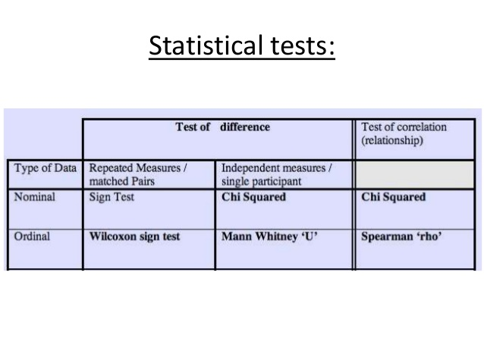

Slide 20
Probability
Probability is the likelihood (shown as a decimal or percentage) that any difference or association between groups has occurred simply due to chance.
When using a statistical test, we must decide on a level of probability that is acceptable (a p value). In psychology, a p value of < 0.05 is usually used. This means that there is a 5% or less chance than our results are due to chance.
A 5% level is chosen because it is believed to give the best chance of avoiding a Type 1 or Type 2 error (explained later).

Slide 21
Significance
If a result is found to be significant, it means that the difference or association between groups is too great to be due to chance.
So, although we may find a difference between the maths ability of males and females, there may not be enough of a difference to be significant. In other words, the difference may be due to chance only.
To investigate this, we would need to conduct a statistical test on the data.

Slide 22
Interpretation of significance
Each statistical test involves taking the data collected in the study and carrying out a mathematical test to produce a single value called the observed value (because it is based on the observations made).
The name given to the observed value varies depending on the test used.
  Chi square = X2
  Spearmans Rho= rho
  Mann Whitney = U
  Wilcoxon = T

Slide 23
Interpretation of significance
The observed value is then compared to another number that is found in a table of critical values (this will be provided for you in the exam). This is called the critical value.
Depending on the test used, our result is significant if the observed value is more or less than the critical value.

Slide 24
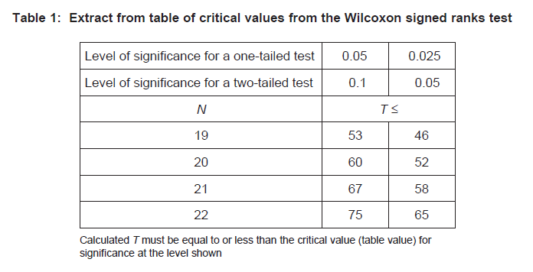
In the exam, you will always be told
whether the observed value should be
more or less than the critical value
THE IMPORTANCE OF R
If the test has an R in it (Chi square and Spearmans), the observed value should be gReateR than the critical value. For tests without an R, the observed value should be less than the critical value.

Slide 25
Type 1/Type 2 errors
A Type 1 error is a false positive. It occurs when we accept the experimental hypothesis as significant when it is not (thus rejecting the null hypothesis).
A Type 2 error is a false negative. It occurs when we reject the experimental hypothesis (and accept the null hypothesis) when it is in fact significant.
The chance of Type 1/2 errors is associated with the significance level (P value) we use. If we use a 1% level, the chance of a Type 2 error is increased, whereas a Type 1 error is more likely when a 10% significance level is used.

Slide 26
Factors affecting the choice of statistical test, including level of measurement and experimental design.

Slide 28
When to use the following tests: Spearman’s rho, Pearson’s r, Wilcoxon, Mann-Whitney, related t-test, unrelated t-test and Chi-Squared test.

Slide 29
T test (Wilcoxon Paired)
A t-test is used when we have 1 IV with 2 levels. It estimates whether the population means under the 2 levels of the IV are different.
The estimate is based on the difference between the measured sample means. There are two types of t-test.
Paired t-test: within participants/ repeated measures.
(Independent t-test: between participants/ independent groups.)

Slide 30
T test (Mann Whitney independent)
Mann-Whitney U is a non-parametric alternative to an independent t-test.
1 IV, 2 levels: Between-participant design.
The test evaluates whether there is a significant difference in the ranks assigned to the two IV levels.

Slide 31
Spearman’s rho and Pearsons R
Pearson product moment correlation
The Pearson correlation evaluates the linear relationship between two continuous variables. A relationship is linear when a change in one variable is associated with a proportional change in the other variable.
For example, you might use a Pearson correlation to evaluate whether increases in temperature at your production facility are associated with decreasing thickness of your chocolate coating.
Spearman rank-order correlation
The Spearman correlation evaluates the monotonic relationship between two continuous or ordinal variables. In a monotonic relationship, the variables tend to change together, but not necessarily at a constant rate. The Spearman correlation coefficient is based on the ranked values for each variable rather than the raw data.
Spearman correlation is often used to evaluate relationships involving ordinal variables. For example, you might use a Spearman correlation to evaluate whether the order in which employees complete a test exercise is related to the number of months they have been employed.

